Slide 1

Using Service Fabric
As a Platform
By Javier D. Perez & Will Tartak

Slide 2

About us
About Javier:
Sr. Software Engineer
7 Years professional software development
4 Years of Enterprise Level Development
3 Years of Micro Service Architecture with Service Fabric
About Will:
Lead Software Engineer
27 Years of professional software development
5 Years of Micro Service Architecture
More than 25 applications currently running in the world

Slide 3
Agenda
Micro Services, Why?
Micro Service Pros & Cons
What Is Service Fabric?
About Service Fabric
Demo
Questions
Resources

Slide 4


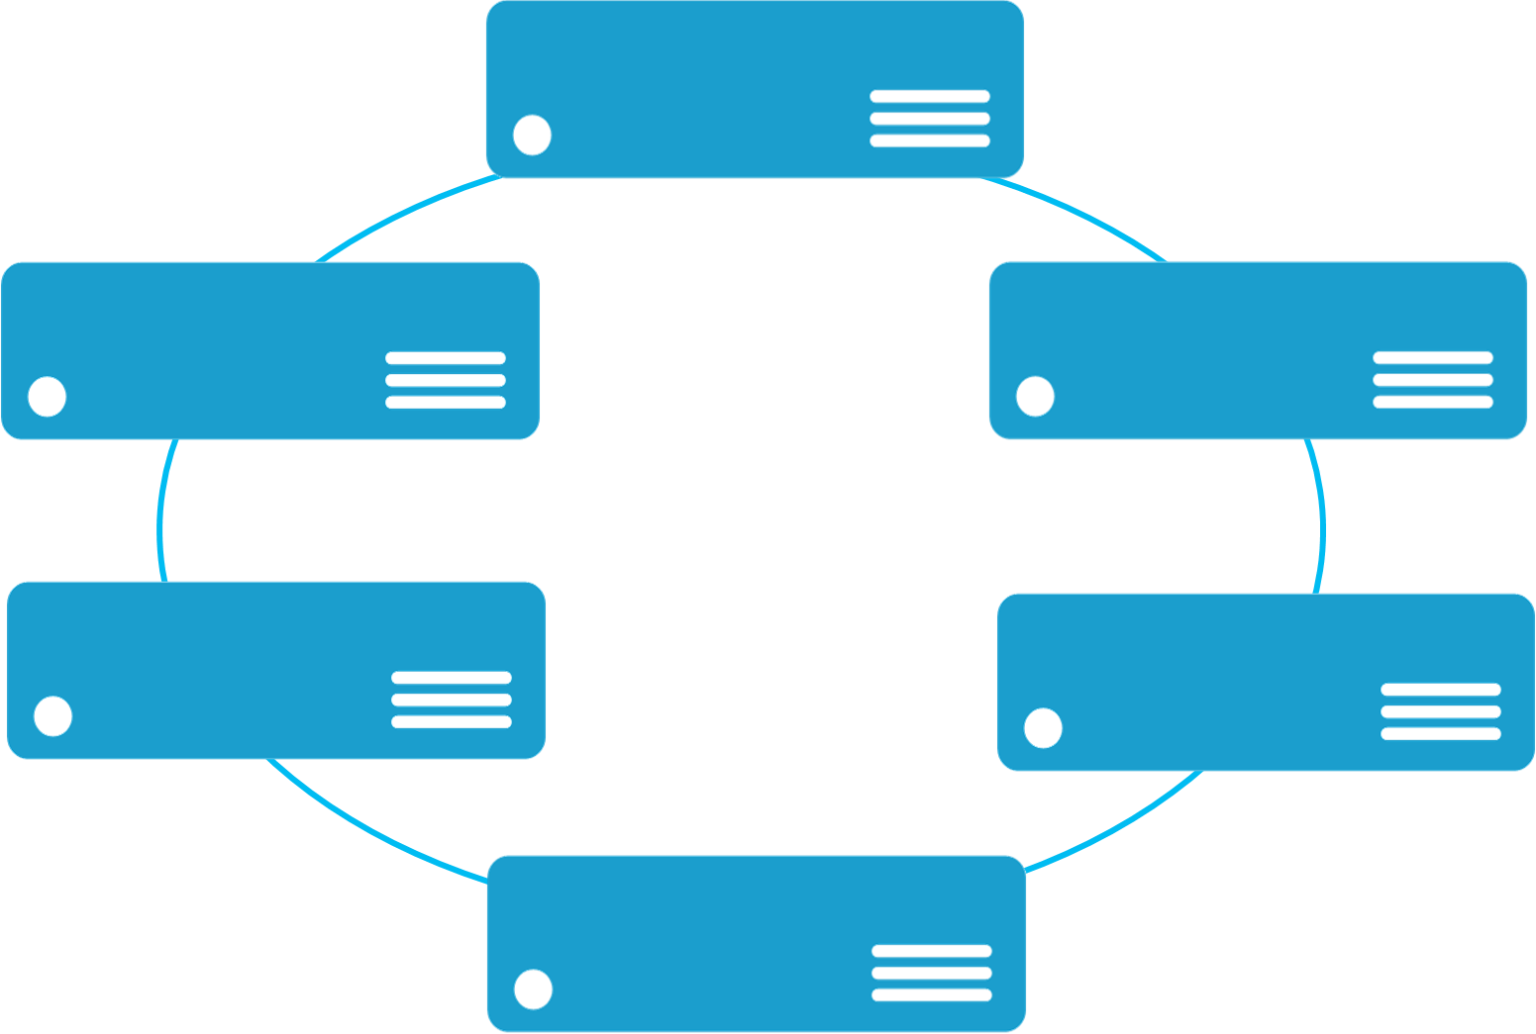


Monolithic application approach
Microservices application approach
A monolith app contains domain specific functionality and is normally divided by functional layers such as web, business and data
App 1
App 1
App 2
A microservice application separates functionality into separate smaller services.
Scales by cloning the app on multiple servers/VMs/Containers
Scales out by deploying each service independently creating instances of these services across servers/VMs/containers
Notes:
Traditional monolithic app couple all their functionality tightly into one service. This means long down time while deploying new feature resulting in fewer opportunities to make updates. Scaling monolithic apps to meet demand is expensive and slow because every component scale at the same rate regardless of use. Likewise availability and reliability are achieved by hardware redundancy adding more cost and complexity.
On the other hand microservices splits each application in a set of fine grained and loosely coupled services that can be upgraded and scaled independently.

Slide 5
Micro service Advantages
Component Level Development
Loosely Coupled Services
Updated & Scaled Independently
Technology Flexibility per Service
Faster Time to Market
Improve Agility

Slide 6
Micro service challenges
Communications between services is complex
Latency
Handling Failures
Management
Services
Deployment & Updates
Scalability

Slide 7

What is Service fabric
Service Fabric is a distributed systems platform that makes it easy to build highly-available, cloud-scale, high performance, easily managed services that can run in either the public cloud or on-premises.
Dev machine
Any cloud
On-premises
Service Fabric Standalone
Azure
Service Fabric
Bring your own infrastructure
Dedicated Azure clusters

Slide 8
What PROBLEM(S) DOES SERVICE FABRIC SOLVE?
Platform Provided Inter Service Communications
Simplifies Building Services
Well understood pattern to add a service to the platform
Service Management
SF Explorer
Scalability Management
Built-in APIs
Protects Against Failures
Deployment & Upgrade Management
Scalable Storage

Slide 9
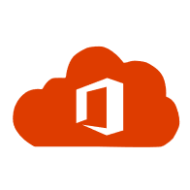



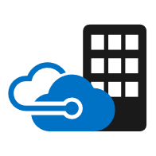











Service Fabric Powers Azure and Microsoft services
Service Fabric is designed for mission-critical services
Productivity | Data/Storage | IoT/Messaging | Other/Azure | Developer
Office 365
SQL Database
Event Hub
Core Azure Services
Azure DevOps
Teams
IoT Hub
Azure Monitor
Azure Container Registry
Cosmos DB
Dynamics 365
Event Grid
Azure Database for MySQL, PostgreSQL, & MariaDB
Azure Stack
Intune
Service Bus
Stream Analytics
Archive Storage
Skype for Business
SQL Database Managed Instance
Azure Sphere
PlayFab Multiplayer Services
Cortana
Digital Twins
Power BI
SQL Data Warehouse

Slide 10
SERVICE FABRIC POWERS
Azure
Core Azure Infrastructure runs on Service Fabric
About 40% of Azure’s compute cores run SF
Millions of SQL Azure Databases
Trillions of CosmosDB Transactions
Trillions of Event Hub Events, Daily
99.99999995% success rate for Service Bus
“Nine Nines and a Five” -> 11 failed messages on 21 Billion requests(!)
Largest production clusters in MSFT are ~1200 machines
That MS know of…

Slide 11















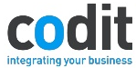
WHO USES SERVICE FABRIC

Slide 12


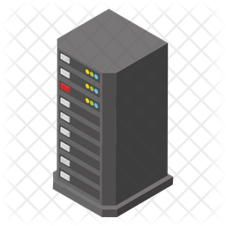


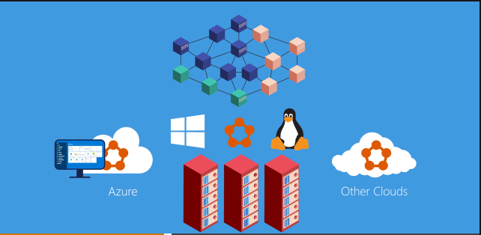
ENVIRONMENTS AND RUNTIME
Same Runtime in each environment, even local dev
Azure
Other Clouds
On Prem

Slide 13

Service fabric cluster
Datacenter (Azure, On-Premises, Other Clouds)
PC/VM #2
App code, etc. (Port: 19081)
Service Fabric
App code, etc.
PC/VM #3
Service Fabric
Load Balancer
PC/VM #1
App code, etc.
Service Fabric
App code, etc.
PC/VM #4
Service Fabric
Web Request. (Port: 80/443/?)
PC/VM #5
App code, etc.
Service Fabric
App code, etc.
Notes:
Cluster supports 1,000s of nodes is self repairing, and scales-in and out

Slide 14
scalability
Cluster Nodes can scale up using Scale Sets
Cluster can scale out (or in)
Explicit APIs
StatelessServiceUpdateDescription
By Partition
Built-In Health APIs, Metrics
Powershell/Az CLI
Scale out happens without any downtime!

Slide 15
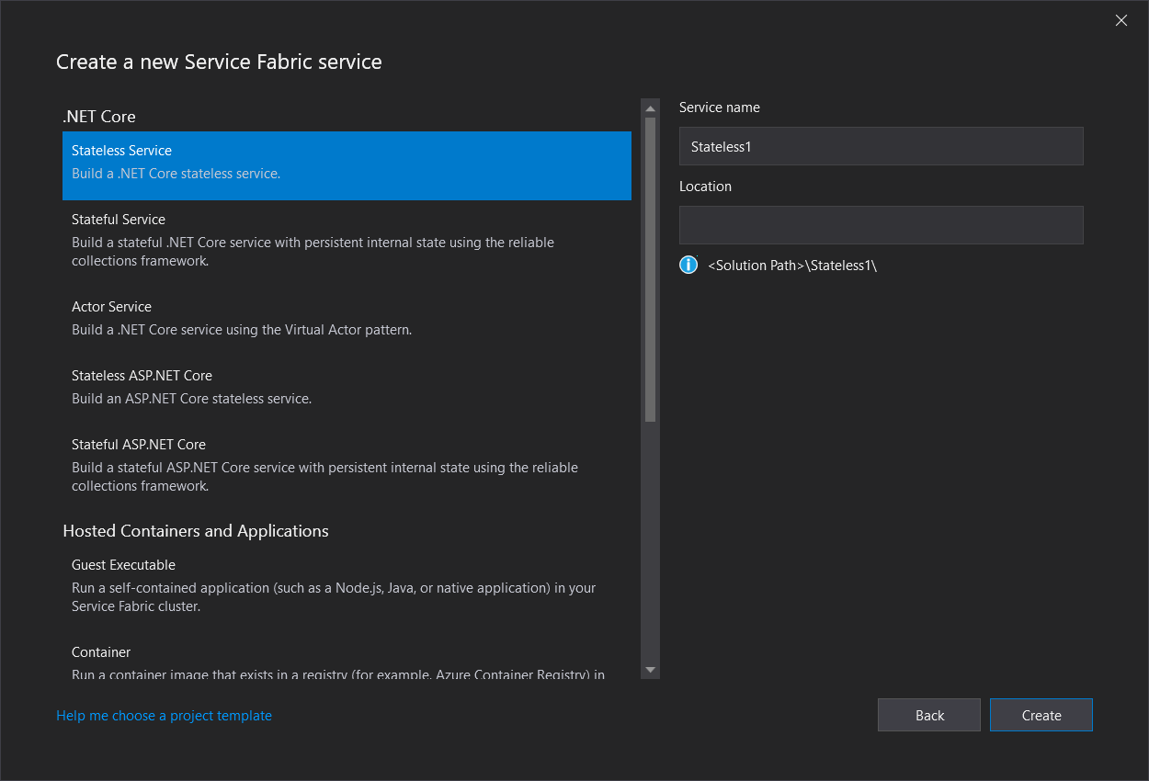
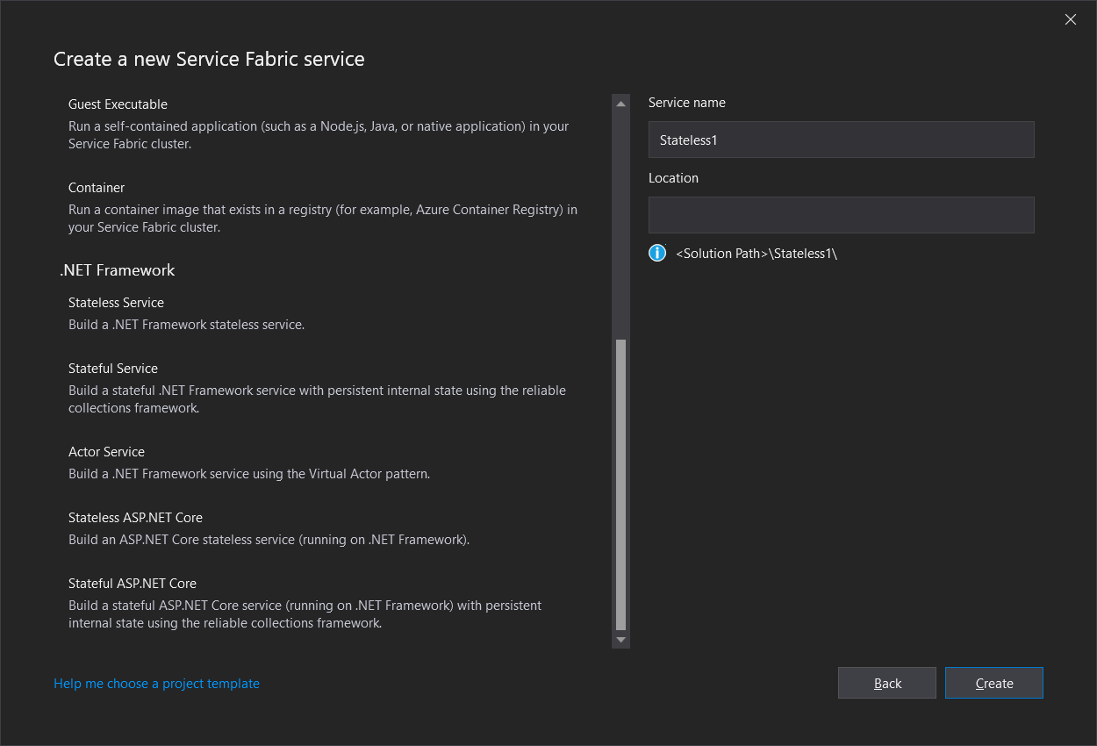
Service types
Stateless
Stateful
Reliable Actors

Slide 16
Communications
HTTP
Reverse Proxy
Service Remoting
WCF
Custom
Notes:
In Service Fabric, a service runs somewhere in a Service Fabric cluster, typically distributed across multiple VMs. It can be moved from one place to another, either by the service owner, or automatically by Service Fabric. Services are not statically tied to a particular machine or address.
A Service Fabric application is generally composed of many different services, where each service performs a specialized task. These services may communicate with each other to form a complete function, such as rendering different parts of a web application. There are also client applications that connect to and communicate with services. This document discusses how to set up communication with and between your services in Service Fabric.

Slide 17
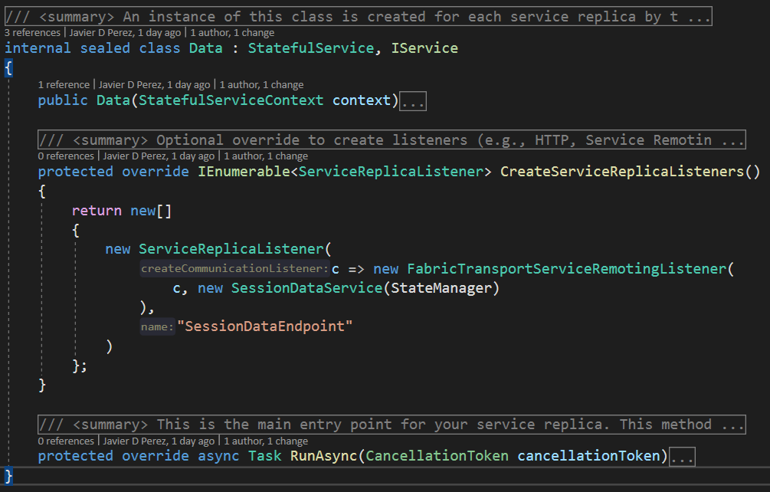
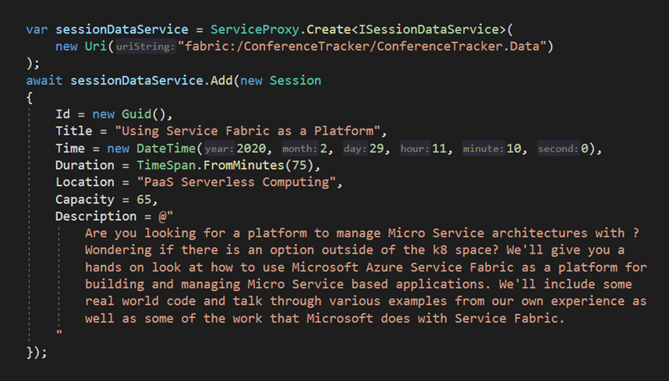
Communications
Service Fabric Remoting
Notes:
In Service Fabric, a service runs somewhere in a Service Fabric cluster, typically distributed across multiple VMs. It can be moved from one place to another, either by the service owner, or automatically by Service Fabric. Services are not statically tied to a particular machine or address.
A Service Fabric application is generally composed of many different services, where each service performs a specialized task. These services may communicate with each other to form a complete function, such as rendering different parts of a web application. There are also client applications that connect to and communicate with services. This document discusses how to set up communication with and between your services in Service Fabric.

Slide 18
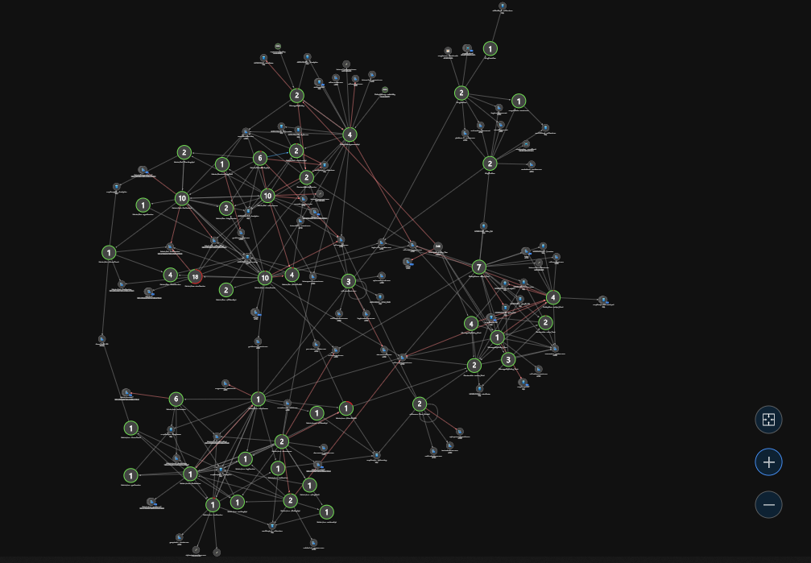


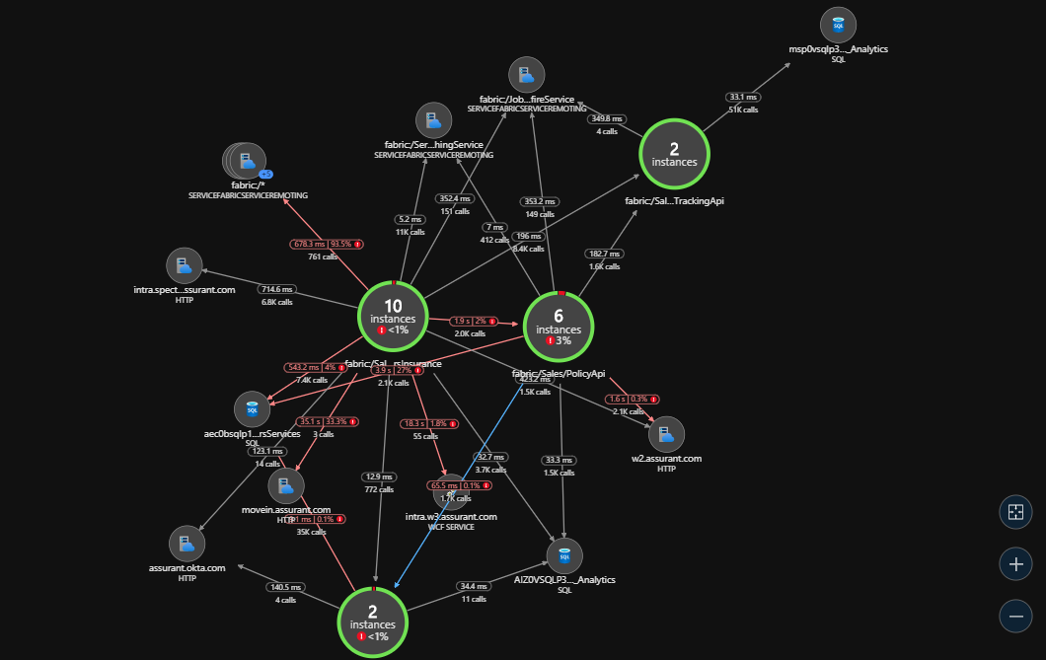
Monitoring
Application Insights
Azure Monitor

Slide 19
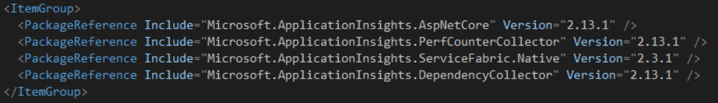
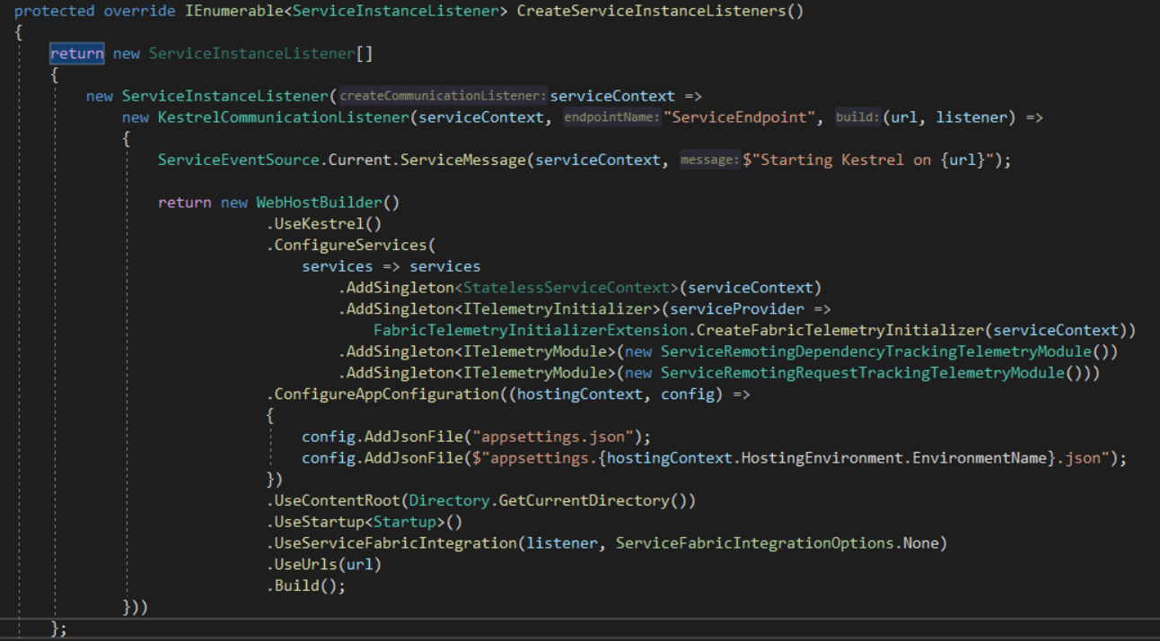
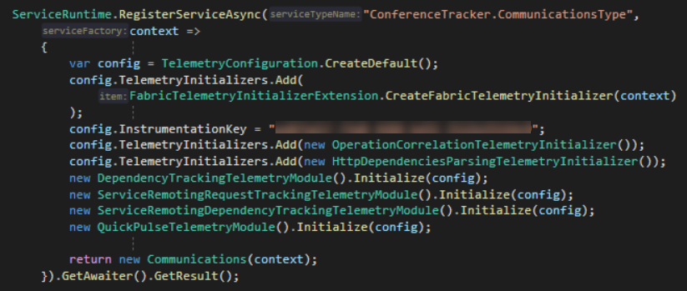
Monitoring

Slide 20
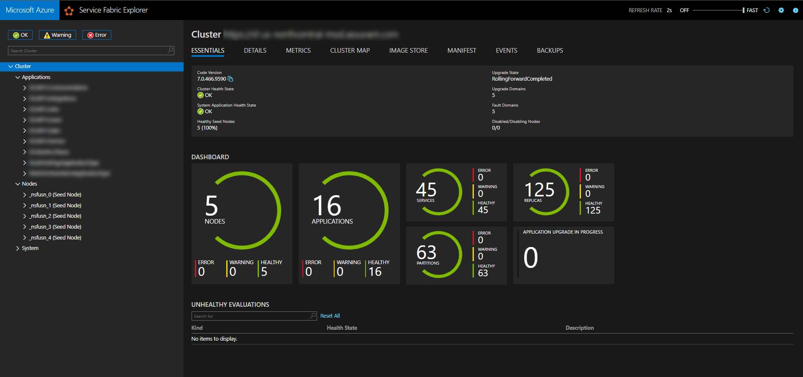
Service fabric Explorer

Slide 21
Demo

Slide 22
In review
Micro Services, Why?
Micro Service Pros & Cons
What Is Service Fabric?
About Service Fabric
Demo

Slide 23
Resources…questions?
https://github.com/javierdpt/conferece-tracker
https://docs.microsoft.com/en-us/azure/service-fabric/service-fabric-overview
https://docs.microsoft.com/en-us/azure/service-fabric/service-fabric-reliable-services-communication-remoting
https://docs.microsoft.com/en-us/azure/service-fabric/service-fabric-connect-and-communicate-with-services
https://twitter.com/servicefabric
Javier D. Perez, javierdavidperez@outlook.com @jpdt89
Will Tartak, will@willtartak.com, @willtartak

